Slide 1
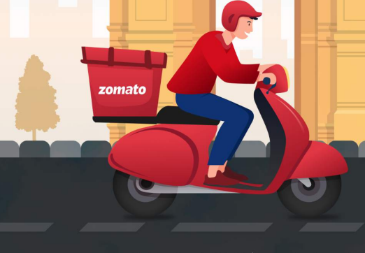
ZOMATO EXPANSION PROJECT

Slide 2

History
Zomato was founded in 2008 as a restaurant discovery platform in India. It started as a website that provided information about restaurants, including menus, reviews, and ratings
Mission
Zomato's mission is to ensure that everyone can find and enjoy great food. They aim to connect users with the best dining experiences by providing accurate and comprehensive information about restaurants.
User Base
Zomato has a large and diverse user base, with millions of active users worldwide. It is available in multiple countries and supports multiple languages, making it accessible to a global audience.

Slide 3
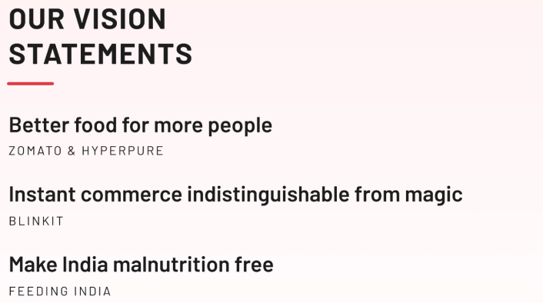
Project Aim
The objective of the project is to analyze the Zomato market scenario based on given dataset and provide meaningful insights, to help in the business growth.

Slide 4
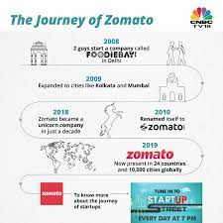
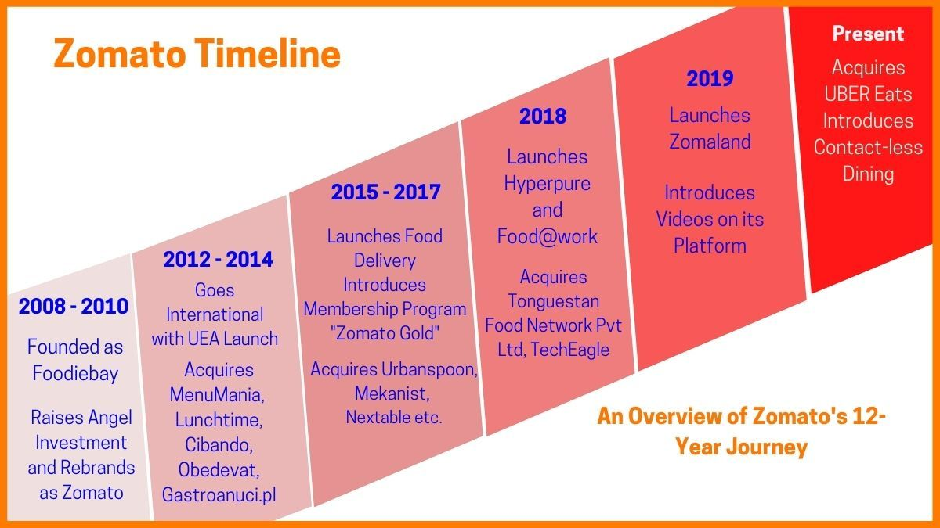
ZOMATO JOURNEY

Slide 5
PROBLEM STATEMENT
SUGGESTING SOME COUNTRIES AND CITIES FOR OPENING NEW RESTAURANTS AND EXPANSION STRATEGIES FOR ZOMATO BY ANALYSING THEIR DATASETS.

Slide 6
Contents
1.Overview
3.Current Scenario
2.Countries & Cities
for Expansion
4.Food Expenditure
5.Competition
6.Cuisines
7.Additional Facilities
8.Main Findings
9.Conclusion

Slide 7
Data Overview
Restaurant ID: Unique identifier for each restaurant.
Restaurant Name: The name of the restaurant.
CountryCode: Country code of the location where the restaurant is situated.
City: The city where the restaurant is located.
Address: The specific address of the restaurant.
Locality: The locality or neighborhood where the restaurant is situated.
Locality Verbose: Detailed information about the locality.
Longitude: The geographical longitude coordinate of the restaurant.
Latitude: The geographical latitude coordinate of the restaurant.
Cuisines: The type of cuisine offered by the restaurant.
Currency: The currency used for transactions in the restaurant.

Slide 8
Data Overview
Has_Table_booking: Indicates whether the restaurant has a table booking option (Yes/No).
Has_Online_delivery: Indicates whether the restaurant offers online delivery (Yes/No).
Is_delivering_now: Indicates whether the restaurant is currently delivering (Yes/No).
Switch_to_order_menu: Indicates whether users can switch to the order menu (Yes/No).
Price_range: A numeric value indicating the price range category of the restaurant.
Votes: The number of votes or ratings/(feedback) received by the restaurant.
Average_Cost_for_two: The average cost for two people dining at the restaurant.
Rating: The overall rating of the restaurant is based on user reviews.
Datekey_opening: The date when the restaurant was opened.

Slide 9
Global Overview
No of restaurant of each country
Chart displays the number of restaurants in each country of the dataset.
India is having the highest number of restaurants i.e. 8652
Second place is occupied by USA with 434 restaurants.
Canada is at the last of the graph indicating least number of restaurants i.e. 4

Slide 10
Market Trends
Derive the number of Restaurants opened each year.
More than 1000 restaurants opened each year.
Highest number of restaurant was open in year 2012, following with 2011, 2013.
After 2015 we can se a drop in 3yrs constantly

Slide 11
Expansion Opportunities
Country for new restaurant open
Heiglighte row in sheet (suggestion_new_resturant)
Country with less restaurant than 200
Restaturnt in that country which has rating >=3
resturant in that coutry which has avg_cost_for_two <=800 and not 0(after converting each avg_cost_for_two to any one currency)
Votes (number of persion visited)>100 in that restaurant

Slide 12
the current expenditure on food in the suggested countries, so we can keep our financial expenditure in control
Cuisines with good ratings i.e. those cuisines which are already performing well in the countries can be introduced in new restaurants branches to generate good amount of revenue at the start. After that we can introduce the local cuisines also according to the future demands by customers.

Slide 13
These Additional Facilities affects customer’s ratings.
Online Table Booking affected
As per the survey, we must opt for online delivery and table booking, It affects the customer’s ratings.
Restaurants offering more services (online delivery and table booking)tend to have higher ratings because customers enjoy additional ease & convenience in their dining experience. Refer to the pie charts for better clarity.
Home Delivery affected

Slide 14
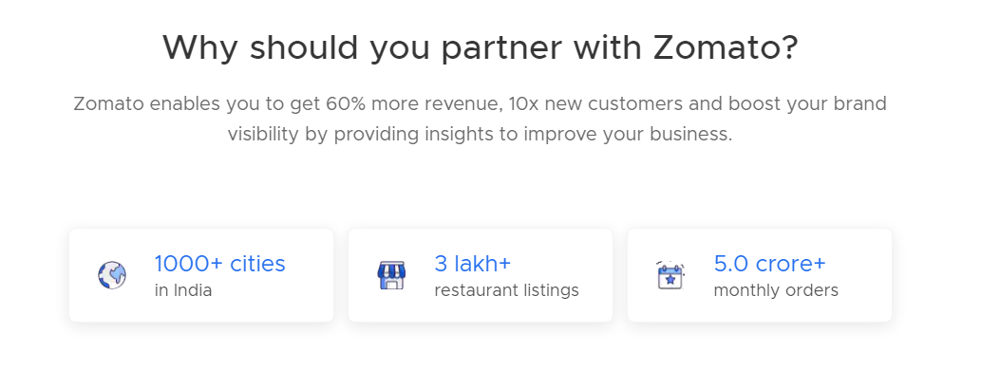
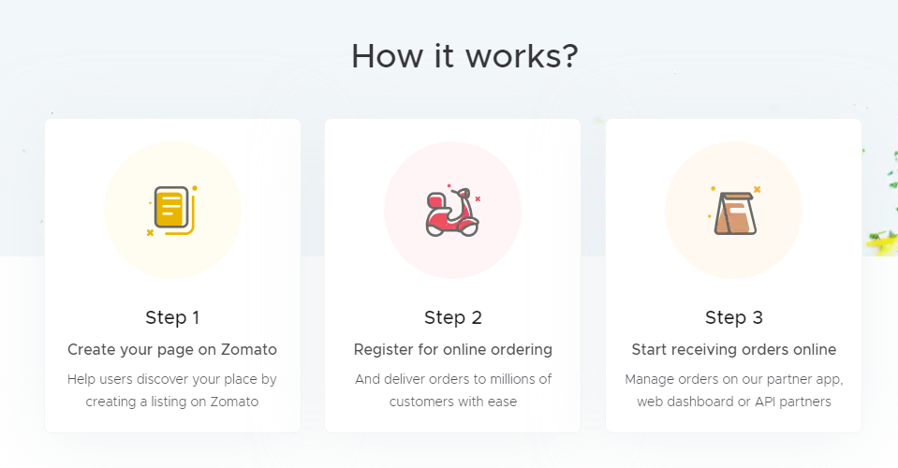
We can offer the current high rating Restaurants to tie up with us.

Slide 15
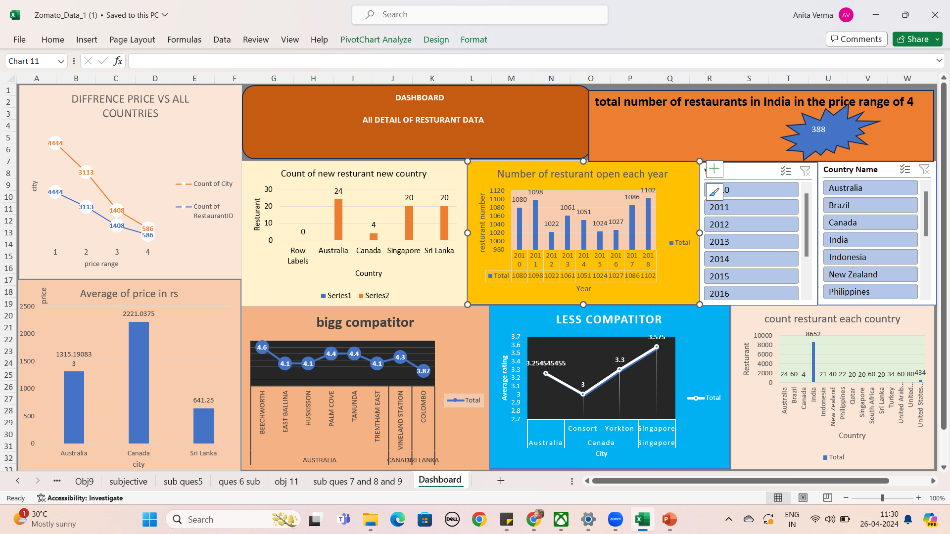
DASHBOARD

Slide 16
Conclusion
Top 4 selected countries for our expansion are Australia, Canada, Singapore, Sri Lanka. Our Major Focus will be on Australia, As this Country has 3 most suitable cities.
According to our data, To get a higher rating, We must keep the rate of cuisines in the middle range, keep high quality cuisines and provide additional facilities in our new Restaurants.
We must offer more services like online delivery and table booking to increase the customer’s ratings because customers enjoy additional ease & convenience in their dining experience.

